Slide 1
CS 4974 Independent Study
9/29/22 meeting
Student: Bug Lee

Slide 2
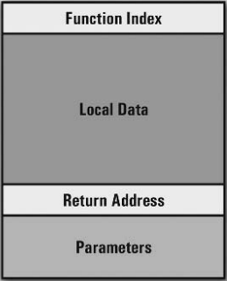
Last time, we discussed…
Loading executable to VM
VM structure/organization
Registers
Instruction stream
Runtime stack
Function Table
String Table
Stack frame (shown in right)

Slide 3
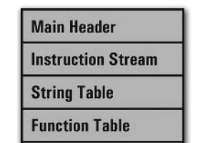
Week 5
compiler
assembler
script.source
script.assembly
script.executable
Virtual Machine
CPU

Slide 4
VM initialization

Slide 5
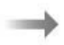
Runtime Stack
VM
Global data size
Main function index
Instruction stream
String Table
Function Table
Frame ptr

Slide 6
Runtime Stack
VM
Global data size
Main function index
Instruction stream
String Table
Frame ptr
Global data
Function Table

Slide 7
Runtime Stack
VM
Global data size
Frame ptr
Main function index
Main func
Stack frame
Instruction stream
Return address: -1
String Table
Global data
Function Table

Slide 8
Runtime Stack
VM
Global data size
Frame ptr
Main function index
Main func
Stack frame
Instruction stream
Instr ptr
= main func
entry point
Return address: -1
String Table
Global data
Function Table

Slide 9
VM execution cycle

Slide 10
Call instruction
Instruction stream
Runtime Stack
Add x, 42
Instr ptr
Call myFunc
.
.
.
myFunc entry point
Frame ptr
Mov x, 1
Main func
Stack frame
Global data

Slide 11
Call instruction
Function Table
Instruction stream
Runtime Stack
Add x, 42
Instr ptr
Call myFunc
.
.
.
myFunc entry point
Frame ptr
Mov x, 1
Main func
Stack frame
Global data

Slide 12
Call instruction
Function Table
Instruction stream
Runtime Stack
Add x, 42
Call myFunc
Instr ptr
.
.
.
myFunc entry point
Frame ptr
Mov x, 1
Main func
Stack frame
Global data

Slide 13
Call instruction
Function Table
Instruction stream
Runtime Stack
Add x, 42
Call myFunc
Instr ptr
.
.
.
myFunc entry point
Frame ptr
Return address: 2
Mov x, 1
Main func
Stack frame
Global data

Slide 14
Call instruction
Function Table
Instruction stream
Runtime Stack
Add x, 42
Frame ptr
Call myFunc
myFunc function index
Instr ptr
.
.
.
myFunc
Local variables
myFunc entry point
Return address: 2
Mov x, 1
Main func
Stack frame
Global data

Slide 15
Call instruction
Function Table
Instruction stream
Runtime Stack
Add x, 42
Frame ptr
Call myFunc
myFunc function index
.
.
.
myFunc
Local variables
myFunc entry point
Instr ptr
Return address: 2
Mov x, 1
Main func
Stack frame
Global data

Slide 16
Ret instruction
Function Table
Instruction stream
Runtime Stack
Add x, 42
Frame ptr
Call myFunc
myFunc function index
.
.
.
myFunc
Local variables
myFunc entry point
Return address: 2
Mov x, 1
Main func
Stack frame
Instr ptr
ret
Global data

Slide 17
Ret instruction
Function Table
Instruction stream
Runtime Stack
Add x, 42
Frame ptr
Call myFunc
myFunc function index
.
.
.
myFunc
Local variables
myFunc entry point
Return address: 2
Mov x, 1
Main func
Stack frame
Instr ptr
ret
Global data

Slide 18
Ret instruction
Function Table
Instruction stream
Runtime Stack
Add x, 42
Frame ptr
Call myFunc
myFunc function index
Instr ptr
.
.
.
myFunc
Local variables
myFunc entry point
Return address: 2
Mov x, 1
Main func
Stack frame
ret
Global data

Slide 19
Ret instruction
Function Table
Local data size, parameters count
Instruction stream
Runtime Stack
Add x, 42
Call myFunc
Instr ptr
.
.
.
myFunc entry point
Frame ptr
Mov x, 1
Main func
Stack frame
ret
Global data

Slide 20
Add instruction
Runtime Stack
Frame ptr
myFunc function index
-2
42
Add x, 1
-3
3
Return address: 2
Main func
Stack frame
Global data

Slide 21
Add instruction
Runtime Stack
Frame ptr
myFunc function index
Add x, 1
-2
42
-3
3
Simplified view of actual instruction
Add 3 -2 0 1
Return address: 2
Main func
Stack frame
Global data

Slide 22
Add instruction
Runtime Stack
Frame ptr
myFunc function index
Add x, 1
-2
42
Operand value
-3
3
Add 3 -2 0 1
Return address: 2
Main func
Stack frame
Global data
Operand type

Slide 23
Add instruction
Runtime Stack
Frame ptr
myFunc function index
Add x, 1
-2
42
-3
3
Add 3 -2 0 1
Return address: 2
Main func
Stack frame
Operand type: stack index
Operand value: -2
Global data

Slide 24
Add instruction
Runtime Stack
Frame ptr
myFunc function index
Add x, 1
-2
42
-3
3
Add 3 -2 0 1
Return address: 2
Main func
Stack frame
Operand type: stack index
Operand value: -2
Global data

Slide 25
Add instruction
Runtime Stack
Frame ptr
myFunc function index
Add x, 1
-2
43
-3
3
Add 3 -2 0 1
Return address: 2
Main func
Stack frame
Operand type: stack index
Operand value: -2
Global data

Slide 26
Instruction that can be run on the current VM
Mov
Add
Push
Call
Ret
Print (new instruction for testing)

Slide 27
Demo

Slide 28
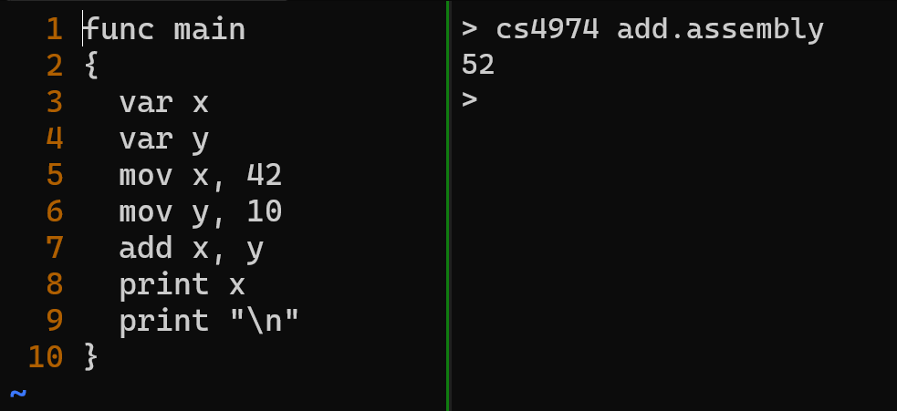

Slide 29
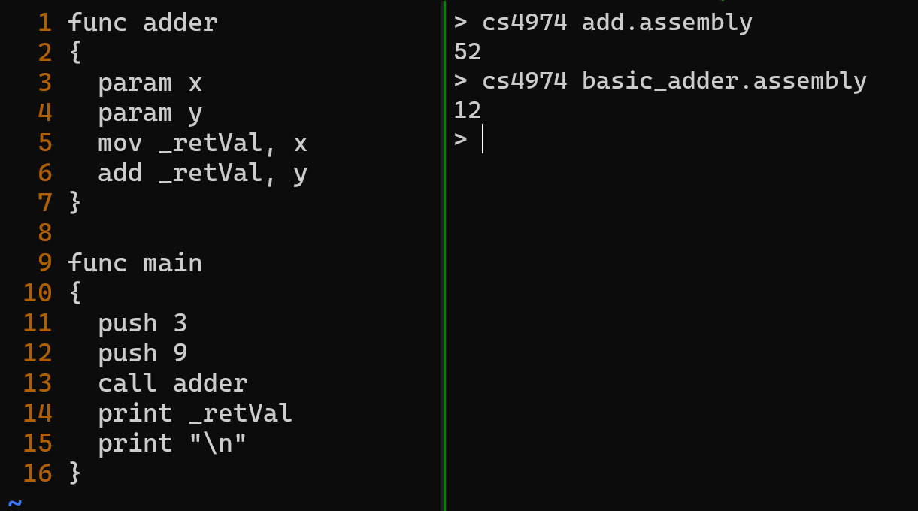

Slide 30
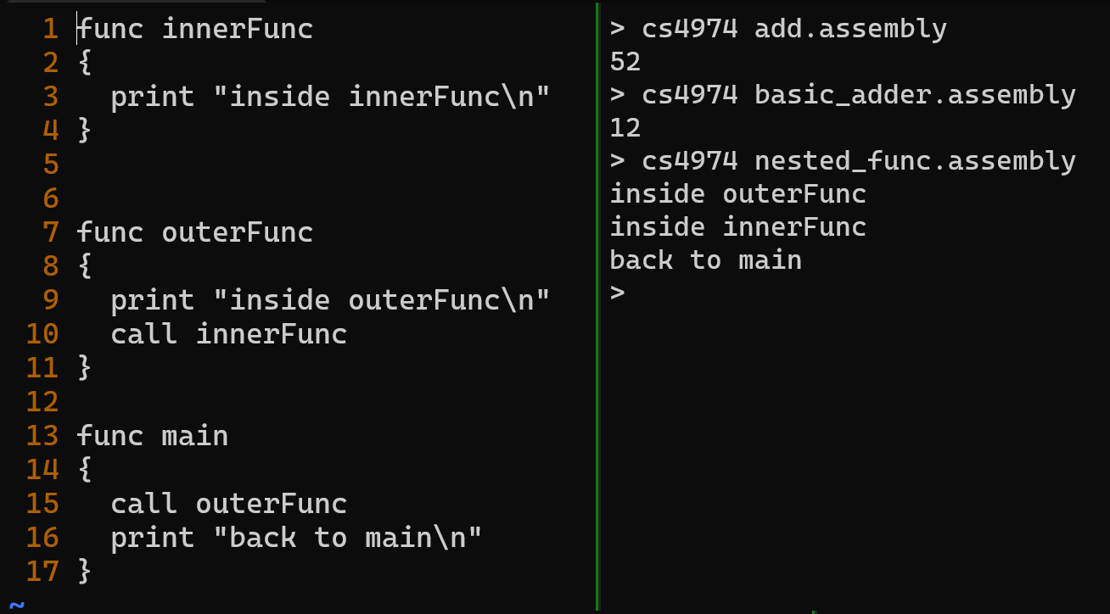

Slide 31
Plan for week 6
Implement remaining 26 instruction execution
Demonstrate VM running program written in Assembly
Bubble/Insertion sort
Simple Calculator
Fibonacci (or program that use recursion)

